Slide 1
The Wilds of Fandom Research:
Watch Out for that Ethical Bear Trap
Alex Willett and Zoe Weinstein
Brandeis University Library

Slide 2
Types of Fandom in Classrooms and Libraries: A Short List
TV
Comics
Movies
Music
Celebrities
Video Games
Trees
Programming
Diets (vegan, keto, etc)
Vampires
Sports
History
Radio
Religion
Anime
Board Games
Apple (tech)
Theater
Musical Theater
Austen, Jane
Books
Podcasts
Art
Knitting
Tabletop Role Playing Games

Slide 3
Some Terminology You Might Hear Today
Fanfiction (fan fiction, fan-fiction)
Fan studies
Aca-Fan/fandom/fen
Slash
Zines, zinesters, distros
(If there’s fandom/fan studies jargon you don’t know, interrupt us and ask!)

Slide 4
Online Fanfiction
(fan fiction, fan-fiction)

Slide 5
Archive of Our Own (Ao3)
Not logged in
Logged in (open beta)

Slide 6
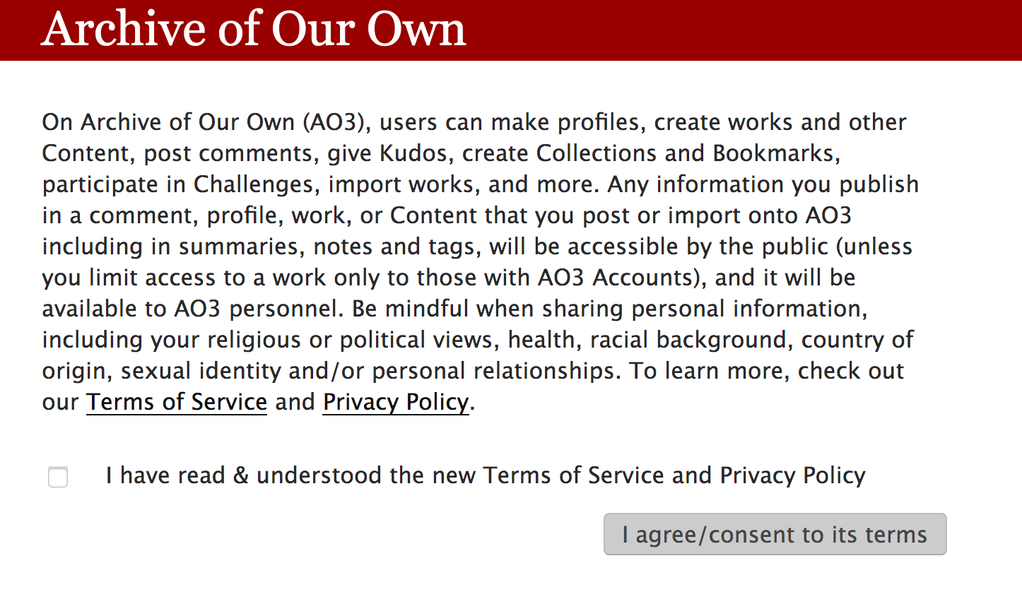
Notes:
Norms and practices within the community

Slide 7
Locked Twitters, Tumblrs, and Instagrams

Slide 8
When the community is private

Slide 9
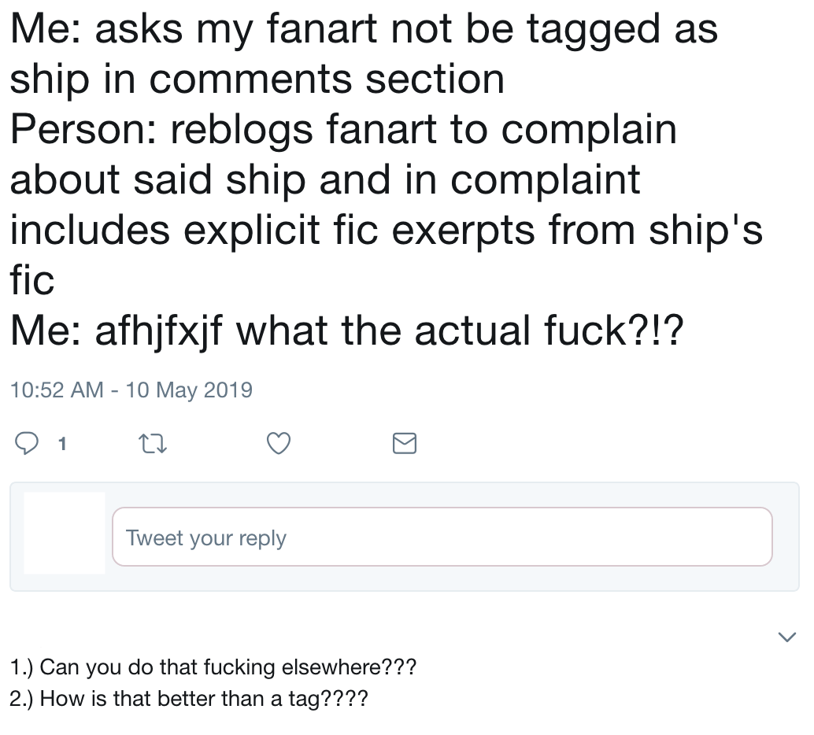
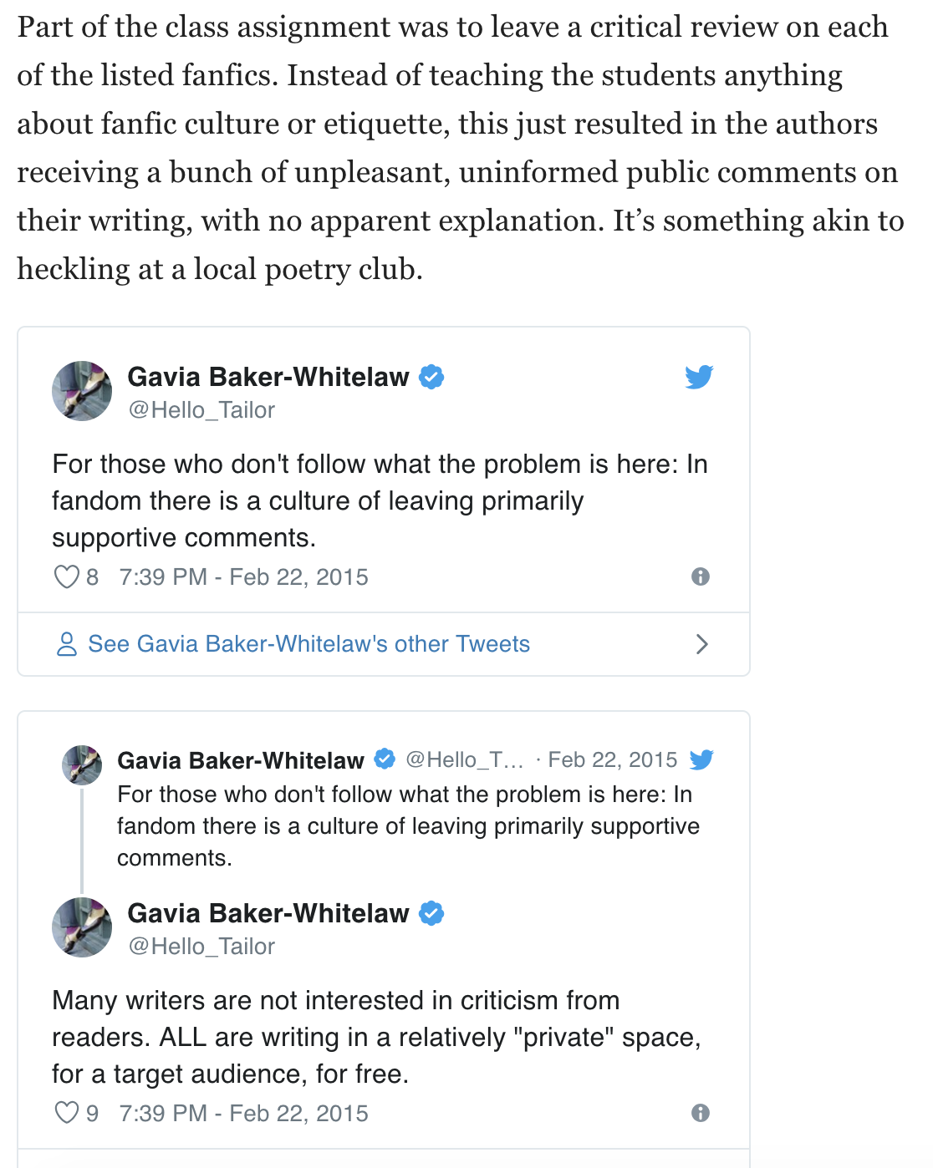
Fandom Mores & Who Follows Them

Slide 10
Zines

Slide 11
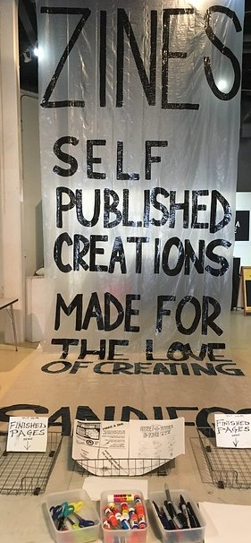
Zines (short for fanzines or magazines)
Self-published works
Often distributed in small runs and/or within specific communities
More about self-expression than profit
Highlight marginalized voices, underrepresented viewpoints
Image: "San Diego Zine Fest 2017" by gzagg

Slide 12
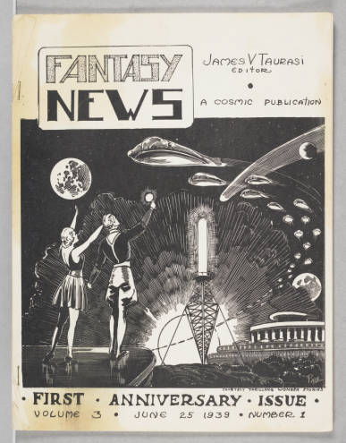
Fanzine Genres: A Short List
Science Fiction (1930s)
Music
Punk (1970s)
Queercore/Homocore (mid 1980s)
Riot Grrrl (1990s)
Crossover
Image: University of Iowa, Rusty Hevelin Collection of Science Fiction

Slide 13
Protecting Fannish Identities
"Post-internet authors have an understanding that their work will be found now. Pre-internet authors did not" (Robertson, 2015).
Fan Culture Preservation Project: partnership between U of Iowa Libraries & the Organization for Transformative Works
Prioritizing fan privacy: metadata, digitization, takedown requests, etc.

Slide 14
Radical Empathy in Archival Practice
Feminist Ethics of Care
Affective Responsibilities:
1st: Archivist & Records Creator
2nd: Archivist & Subject of Records
3rd: Archivist & User
4th: Archivist & Community (Caswell & Cifor, 2016)
Radical Empathy in Zine Librarianship (Wooten et al., 2018)

Slide 15
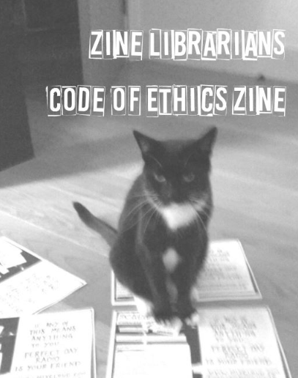
Zine Librarians Code of Ethics
Access vs. Use
Reading vs. Citing/Reproducing
Zine Context & Distribution
Citing & Requesting Permissions
Copyright & Fair Use
(Berthoud et al., 2015) zinelibraries.info

Slide 16
Strategies for searching across multiple media

Slide 17
Searching for Zines
Libraries: Academic, public, barefoot, etc.
Controlled & uncontrolled vocabulary
LC Subject Headings, Anchor Archive, etc.
Fanzines vs. Fan Magazines
Etsy, distros, zinefests, etc.
ZineWiki
Zine creators

Slide 18
Fandom Primary Sources
Archive of Our Own
Hevelin Fanzines (U of Iowa)
Queer Zine Archive Project (QZAP)
Reddit
Twitter (and Twitter advanced search!)
Tumblr
(and how to get Google to search these for you)

Slide 19
Secondary Sources
Journal of Television and New Media
Transformative Works & Culture
Journal of Fandom Studies
Google Scholar (no joke)

Slide 20
Tertiary Sources
ArchiveGrid
Fanlore
Know Your Meme
Television Tropes
ZineWiki

Slide 21
The view from inside these spaces

Slide 22
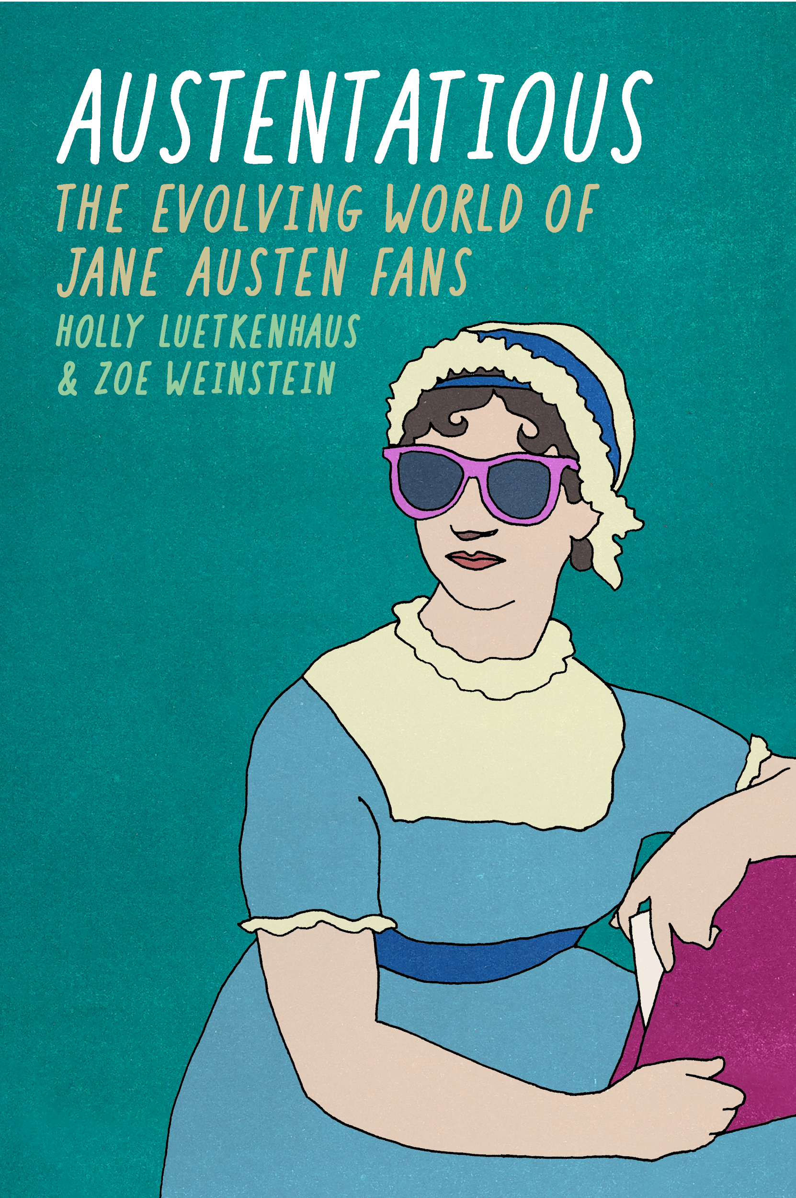
Thank you! Questions?
Alex Willett GIS & Social Sciences Librarian Brandeis University awillett@brandeis.edu
Zoe Weinstein Humanities Librarian Brandeis University
ztweinstein@brandeis.edu
Co-Author, Austentatious: The Evolving World of Jane Austen Fans, out June 3

Slide 23
References
Baker-Whitelaw, G. (2015, February 23). What not to do when teaching a class about fanfiction. The Daily Dot. Retrieved May 7, 2019 from https://www.dailydot.com/irl/berkeley-fanfiction-class-backlash/
Berthoud, H., Barton, J., Brett, J., Darms, L., Fox, V., Freedman, J.,... Wooten, K. (2015). Zine librarians code of ethics. Durham, NC: Zine Librarian Interest Group.
Caswell, M., & Cifor, M. (2016). From human rights to feminist ethics: Radical empathy in the archives. Archivaria, 81(1), 23–43.
Click, M. A., & Scott, S. (Eds.). (2018). The Routledge companion to media fandom (1st ed.). New York London: Routledge, Taylor & Francis Group.
Robertson, A. (2015, September 4). 10,000 zines and counting: A library’s quest to save the history of fandom. Retrieved October 31, 2018, from https://www.theverge.com/2015/9/4/9257455/university-iowa-fanzine-fan-culture-preservation-project
Wooten, K., Fox, V., McElroy, K., & Vachon, J. (2018). Each according to their ability: Zine librarians talking about their community. In The Politics of Theory and the Practice of Critical Librarianship. Retrieved October 31, 2018, from https://dukespace.lib.duke.edu/dspace/handle/10161/16441

